Slide 1



COMSC 165 Semester Project
Creating an App to Understand Place Value and Operations in Base Ten
Fall 2020
Michael Nardo

Slide 2
Summary of why I created this app:
These are the reasons why I created this software and it mostly relates to Elementary Common Core Math and its Standards:
  To aid students in K-5 to understand certain Math Common Core Standards taught in many California schools.
  Understand place value [1.NBT.2.c, 2.NBT.1.b]
  Visualize how we can decompose whole numbers and read them in Expanded Form [2.NBT.3]
  Learning about rounding to the nearest 10, 100, and so on up to the billions place [3.NBT.1, 4.NBT.3]
  Show what numbers compute to when adding or subtracting 1, 10, and 100. [1.NBT.5, 2.NBT.8]

Slide 3
My Personal Reason:
Having worked in education for about 5 years as a substitute and a summer schoolteacher for elementary-level classes, I have thought about how we can aid students who may be having a difficult time in Math. I have noticed that there is a growing trend of using laptops/PCs to automate teaching in the classroom, whenever there is Computer Lab or laptop/tablet time in the classroom.
Although my app isn’t fancy or colorful compared to the apps, websites, or software that students are currently using that tend to grab their attention, my app is more of a tool designed to aid students with the reasons on why I created the app.

Slide 4
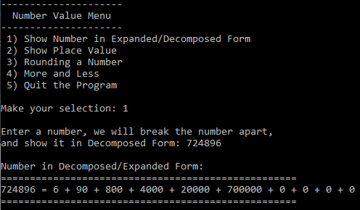
Overview
When you start the software, you are shown a selection of things to choose. When you select your choice, you will be prompted to enter a number.
In this shot, we have selected ‘1) Show Number in Expanded/Decomposed Form’ and will ask the user to enter a number, which will be decomposed and put in expanded form mathematically.
Once you have entered your number, you will be given an output. In this case, you will be given its Standard Form (in this case, 724896) and will be given its Base Ten numerals.

Slide 5
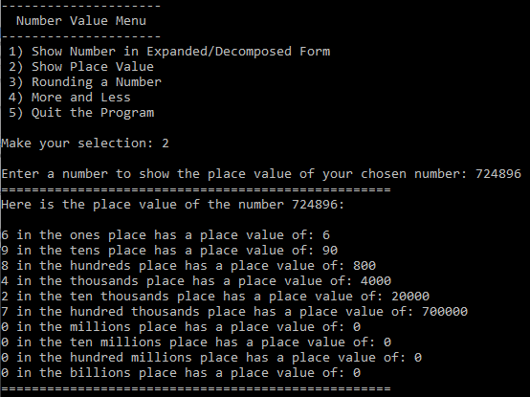
Overview
Selecting ‘2) Show Place Value’ will ask the user to enter a number and it will show you the number in its place value, starting in the ones and ending in the billions place.
When giving a number that is not in the billions place or less for example, the output maintains whether it has a base ten or not by outputting the number 0 (eg 724896 does not show a place value or base ten number), which means those statements are not part of the output.

Slide 6
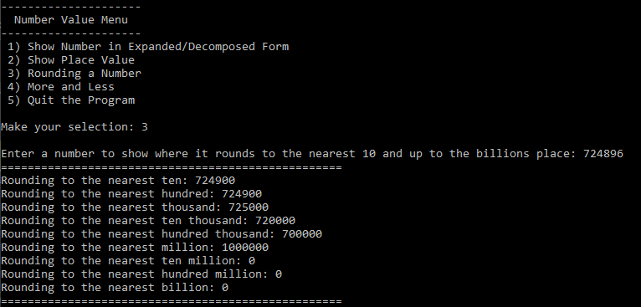
Overview
When choosing ‘3) Rounding a Number’, user enters a number and depending on the number, expect when it is up to the billions place, it rounds the number to its nearest said value.

Slide 7
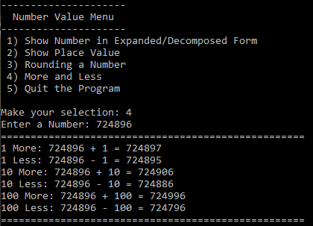
Overview
The mode ‘4) More or Less’ simply outputs what your entered number looks like when we add or subtract 1, 10, and 100.

Slide 8
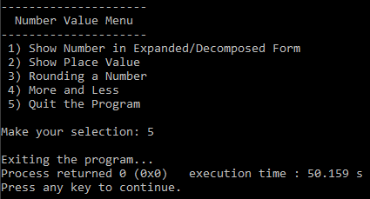
Overview
And since this is a menu, it always needs a way to exit out of the program when you are done with the program.

Slide 9
Figuring out which grade this app is most useful to in terms of learning place value
I feel this was the biggest challenge I had to face because as much as I wanted to cover more of the Common Core Standards pertaining to place value, I feel like I have created a draft of what is possible with creating a software program that involves elementary-level math. So instead on focusing on one grade, the app would encompass usage for all grades whenever possible. I’m not sure about Kindergarten would see this as useful, knowing that they would need to have a more visual and mental way of learning place value like using a Ten Frame and composing/decomposing numbers from 1 to 20, which doesn’t provide that simplicity, though I could add that into the app in some way.

Slide 10
Programming Challenges
Even though it took me hours to configure my code to run and output what I wanted to see, the programming was the least of my worries, compared to my other challenges I faced for this project.
Initially, I was manually calculating every output that required a divisor and modulo operator, but then I realized I could automate the calculations more efficiently by using a for loop. Despite that, whenever a number was entered, there was some output that was probably not needed. Like when a 3-digit number is entered, it doesn’t need to show that it can’t round to the millions place, but I accepted it and realized that it would be best to show that output to show proof that a 3-digit number is in the hundreds and not in the millions.

Slide 11
Bugs in Code
There are some bugs in the code, most of which deal with the input of a number. Whenever you are prompted to enter an integer and you just happen to type in a number that reaches more than ten billion or 2,147,483,647, the program will create an infinite loop unless you quit the program via window screen. I don’t expect who I would assume my userbase for this app, an elementary student to type in a large number like that to figure out a place value, as I expect them to use numbers in the 1000s or millions at least.

Slide 12
Future Work
There is a lot I could’ve added to my functions, like the ability to place value decimals but couldn’t figure out the right calculations and how to correctly output the placement value for those numbers.
Another thing I could have done was to make the output cleaner since I could not find any other way to omit rounding to a smaller number when it’s calculating the modulo, to skip a step or two when it’s not needed (e.g. In rounding 56421, there is no need to show place value in the millions to make the output shorter to read).
If I had more time to develop this app, I would expand the app to cover all the Math Standards, including comparing “…two three-digit number based on meanings of the hundreds, tens, and ones digits using >, =, and <. [2.NBT.4]

